Slide 1






Unveiling the Drivers of
Fetal Weight Estimation
Which Ultrasound Measurements Matter Most?
Vasilis Tsilidis, Department of Mathematics, University of Patras
Joint work with V. Bitsouni (UPatras) & N. Gialelis (NKUA)
15 July, 2025

Slide 2
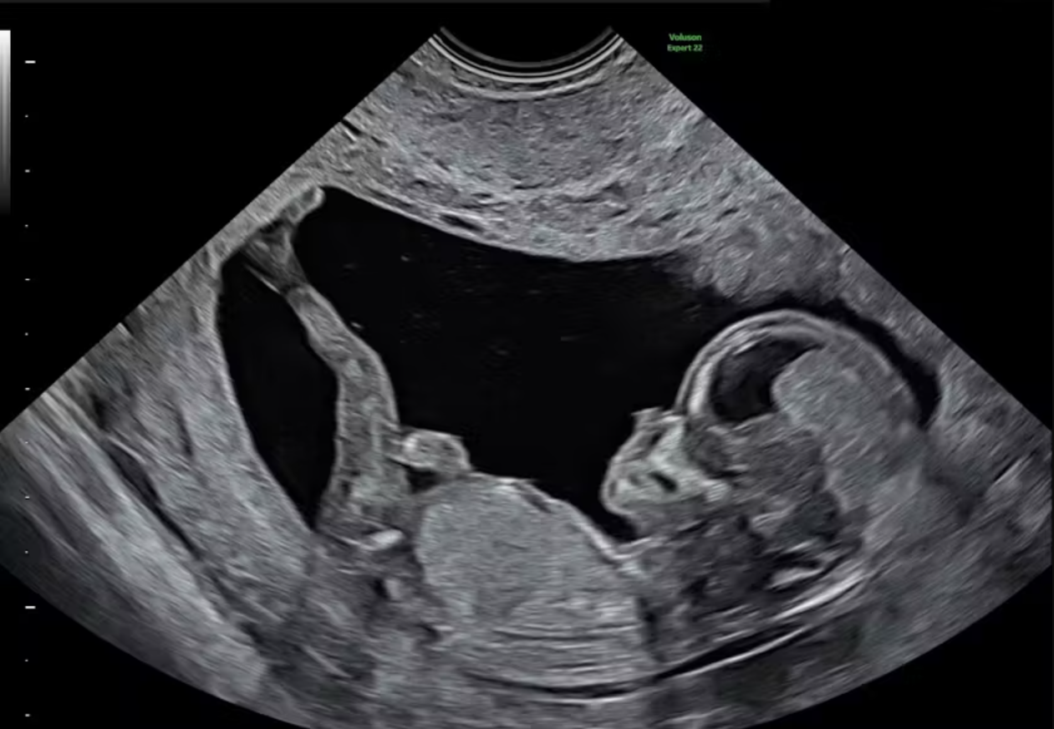
Notes:
This is the picture of a human fetus. It was taken at around the 20th week of gestation.
The technique used for capturing this image is called ultrasound imaging, or sonography.
Ultrasounds are performed for several important medical reasons throughout gestation such as determining the gestational age, assessing fetal anatomy and monitoring the fetal weight.
But how is fetal weight estimated via just some images?
The first step involves taking biometric measurements from sonograms.

Slide 3
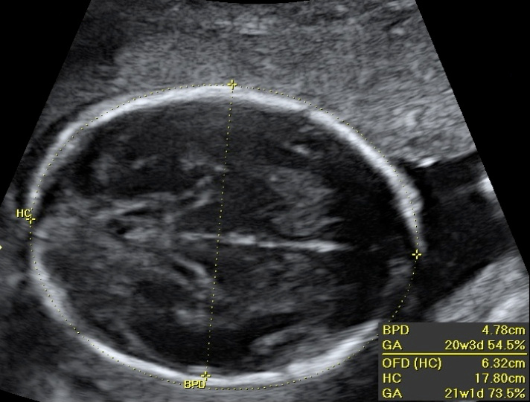
Notes:
Here, we see another sonogram, this time of the head of a fetus from a top view.
If you ask me, it’s kind of hard to tell if this is even an actual human head, so let’s highlight some specific areas of interest.

Slide 4
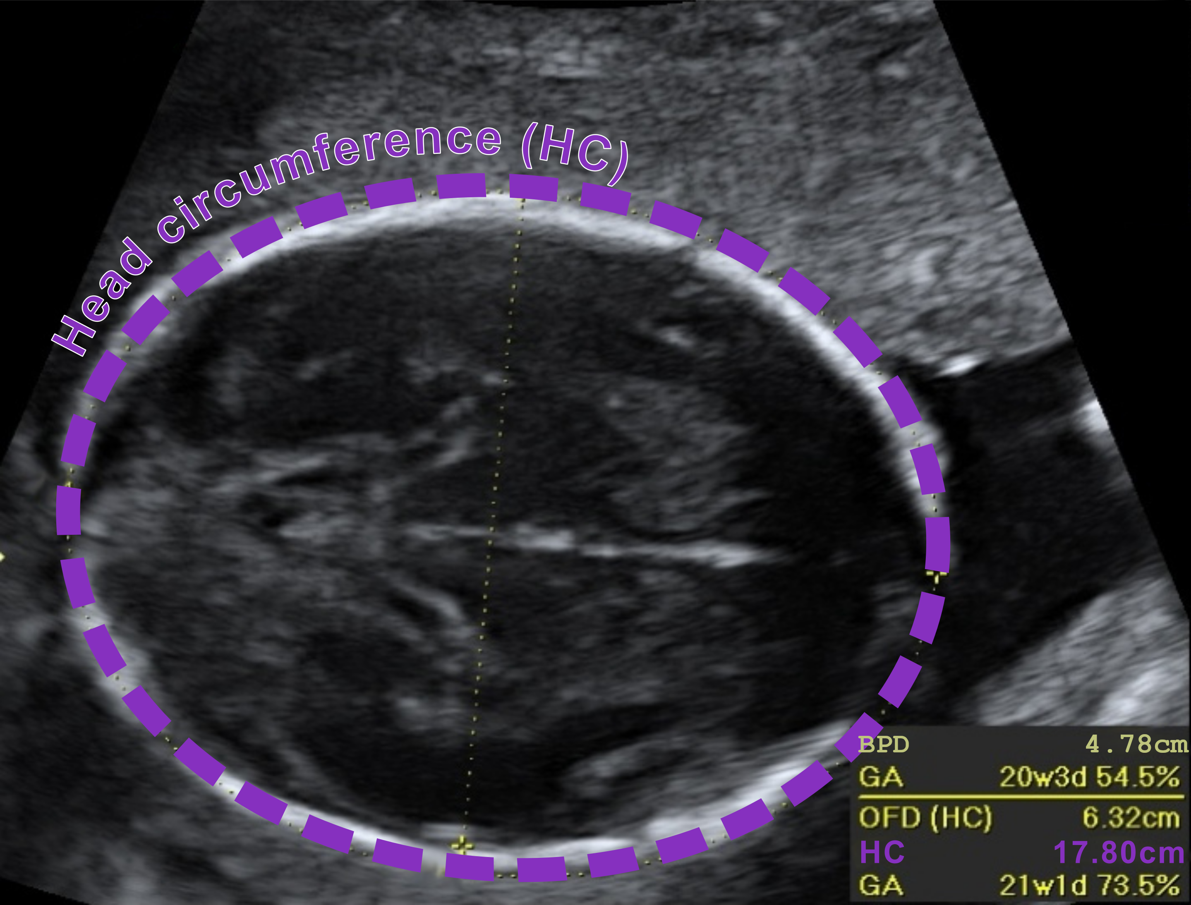
Notes:
The purple curve represents the head circumference of the fetus. A sonographer measures this circumference and throws it into some mathematical formula as an input which in turn makes an estimation about the current weight of the fetus. Is head circumference the only measured biometric variable?

Slide 5
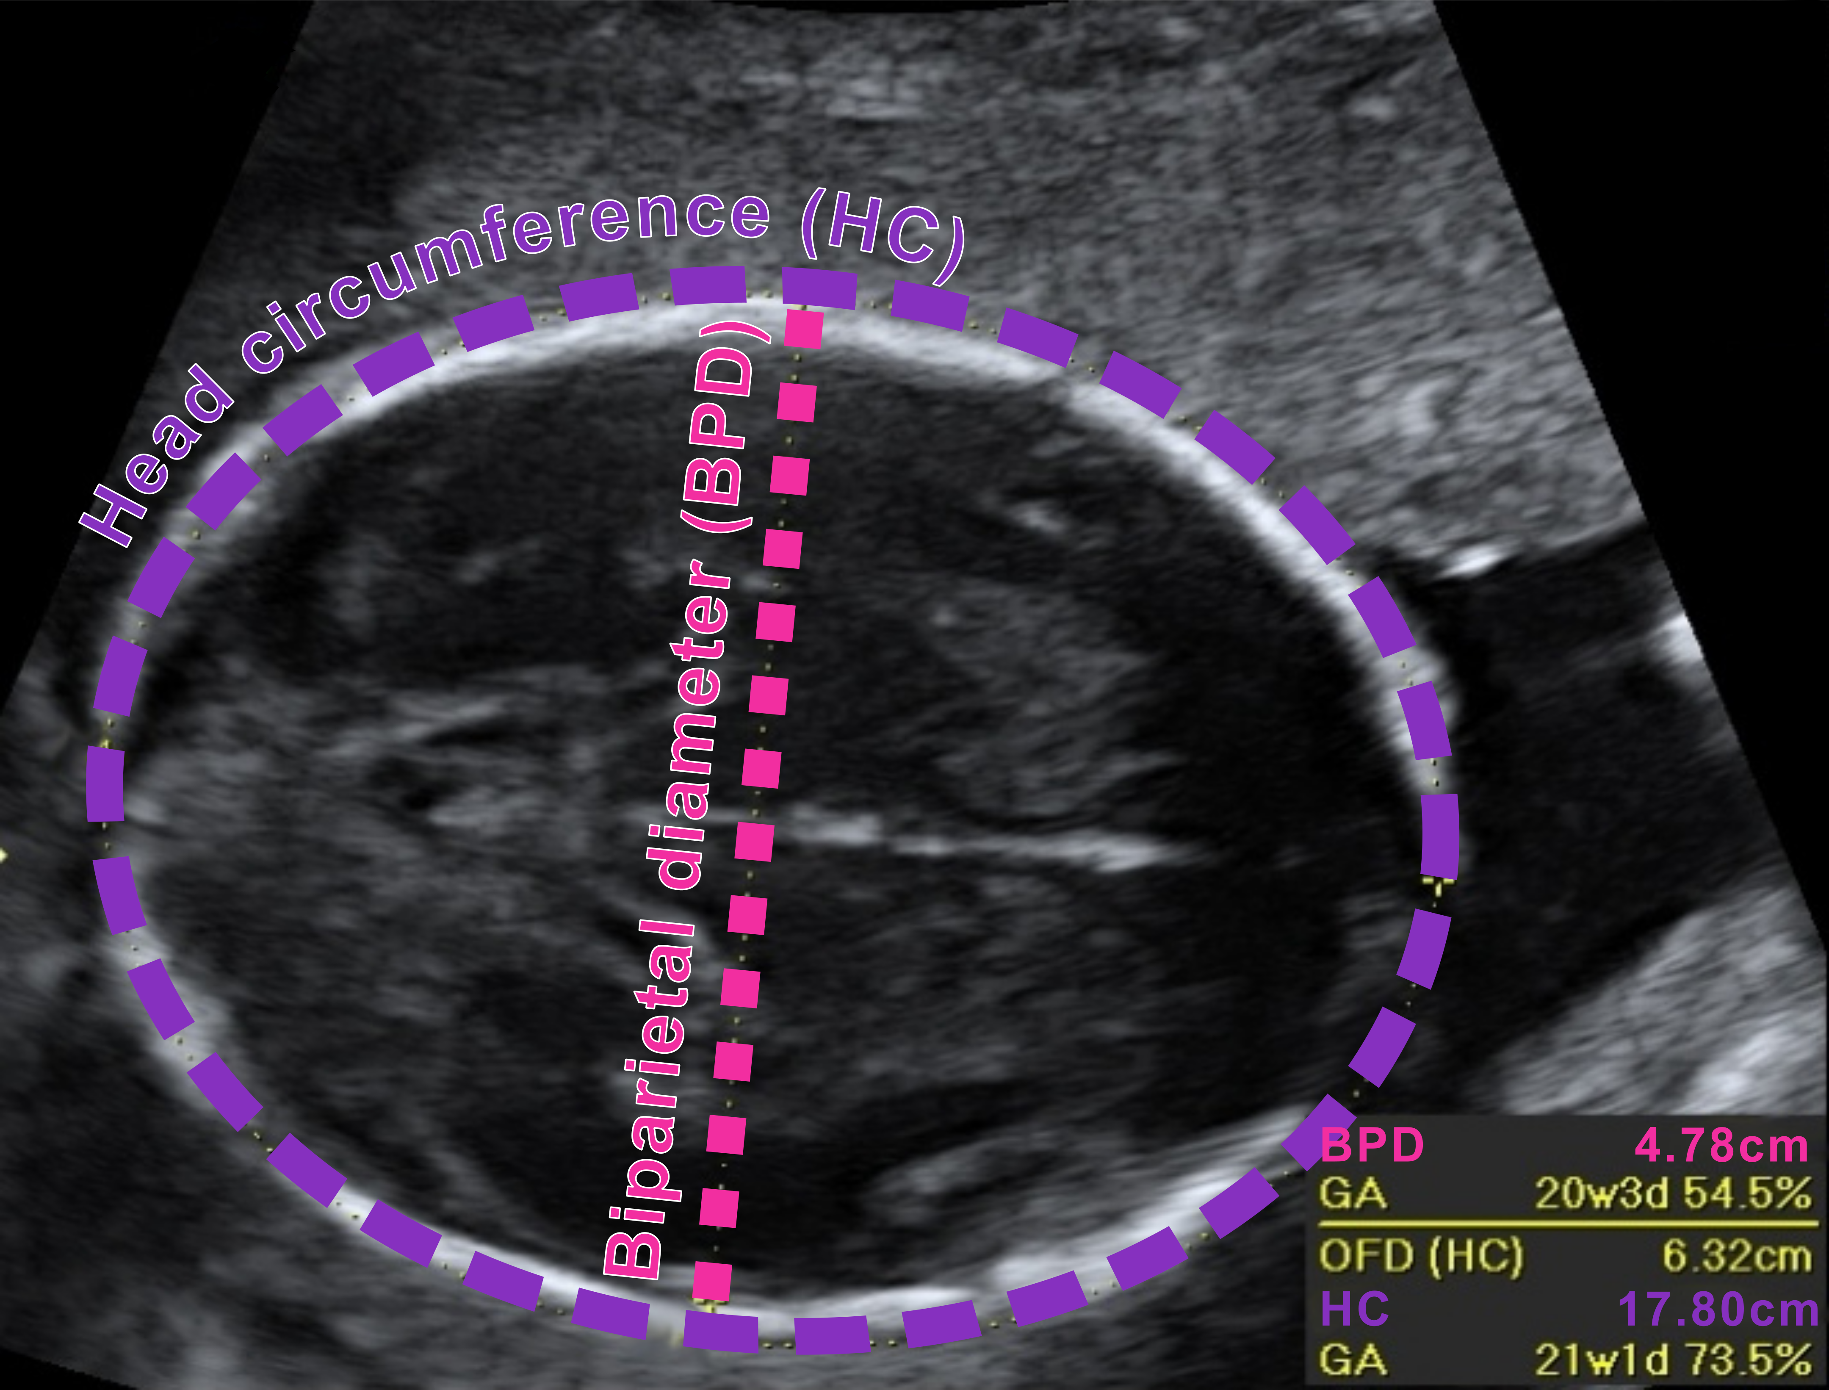
Notes:
No, it’s not. The pink line represents another biometric parameter, the biparietal diameter, which measures the width of the fetal head. Both the biparietal diameter and the head circumference can be measured from the same sonogram.

Slide 6
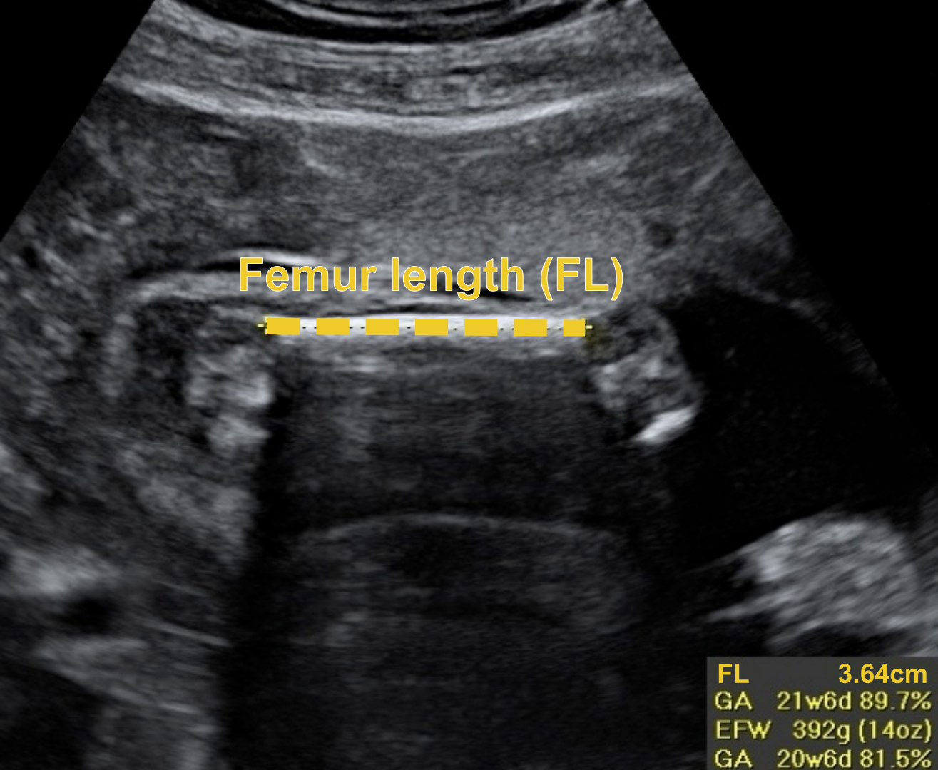
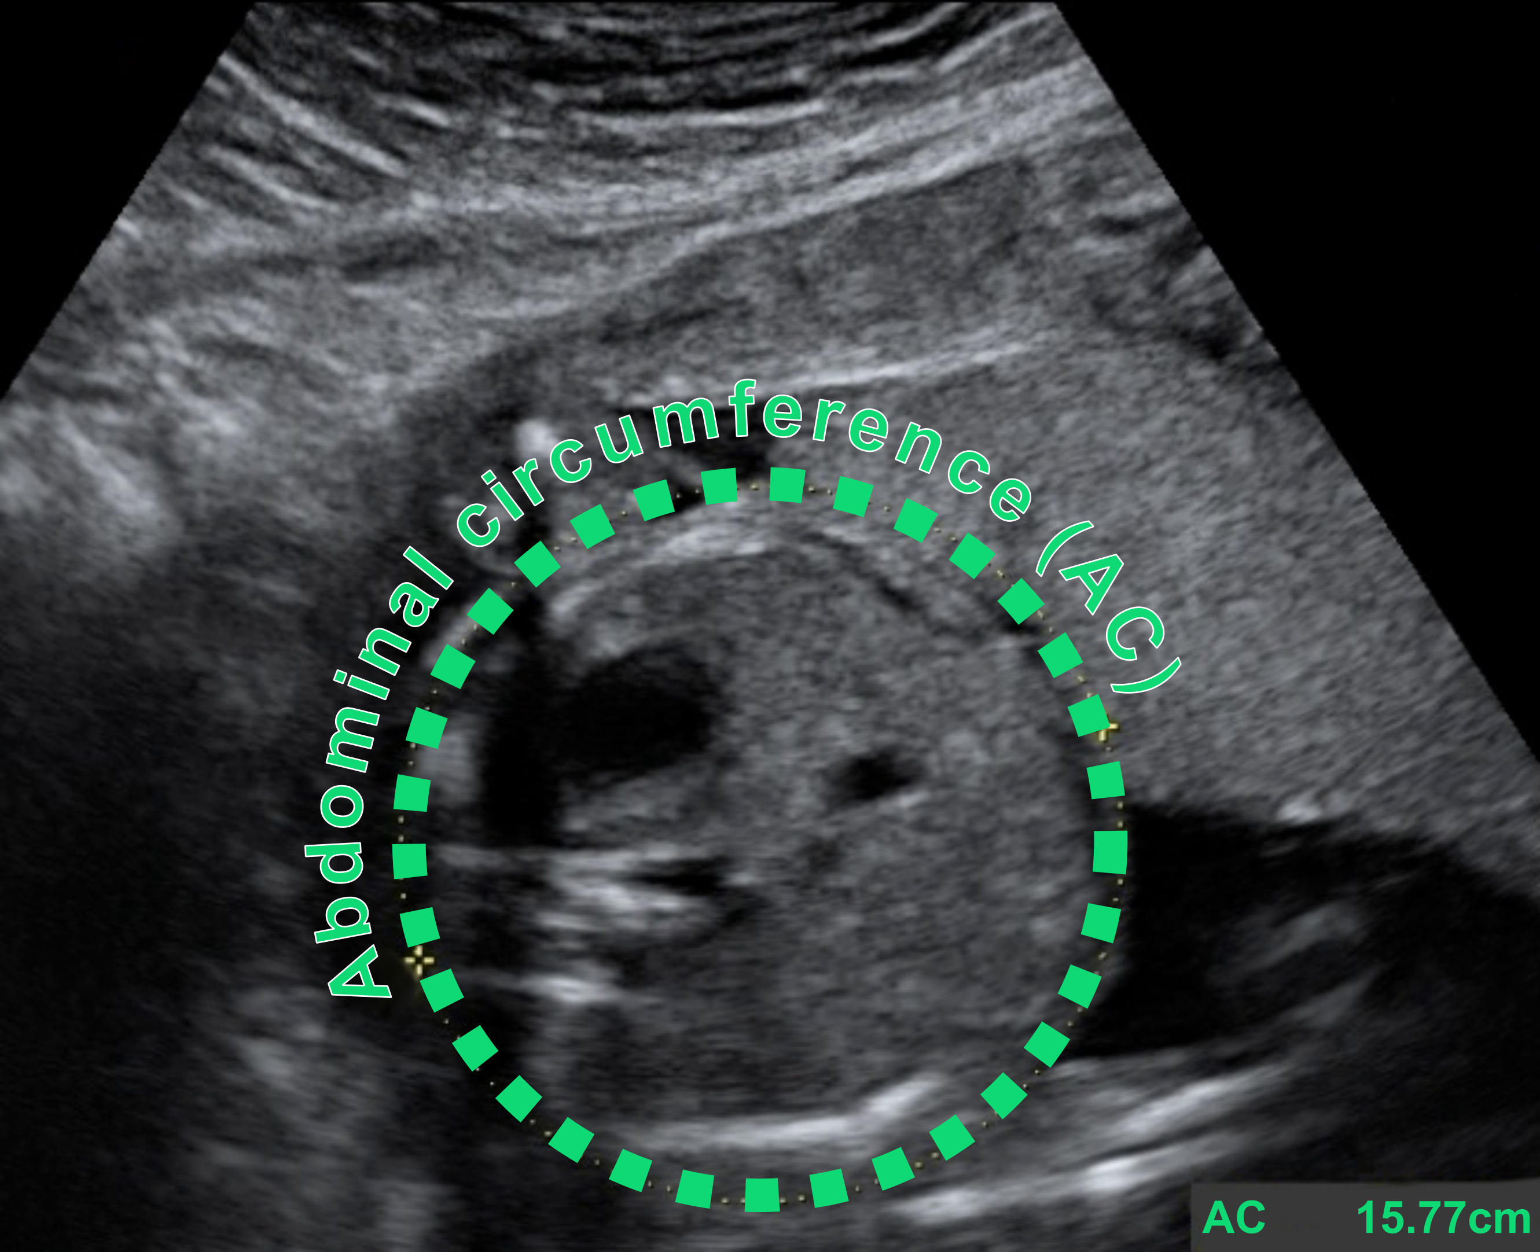
Notes:
Two additional biometric parameters, that need their own sonogram, are the abdominal circumference and the femur length, that is the length of the thigh bone.
Today we’re only going to talk about the aforementioned four biometric parameters since they are the ones with the widest use, but in general, there are more that can be used for fetal weight estimation.

Slide 7
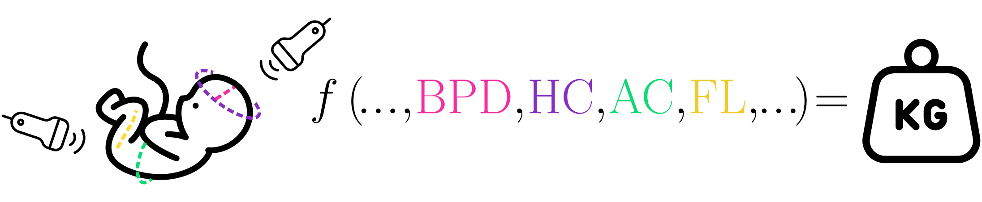


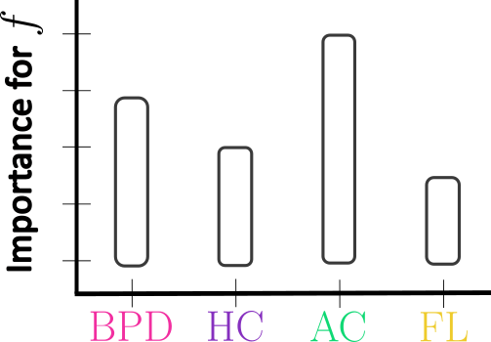

Notes:
So, to sum up, fetal weight estimation is a two-step process. Firstly, an ultrasound is performed in order to measure specific biometric parameters, which are then thrown into some mathematical formula which in turn makes a prediction about the fetal weight.
Many fetal weight estimation formulas exist in the literature and are daily used for this task. Additionally, many studies exist that compare the accuracy (άκιουραση) of those formulas. However, no research has been conducted that systematically assesses the contribution of the involved parameters of each formula to the EFW, and this is exactly what we are going to discuss today.

Slide 8


Agenda Overview
A
Methodology
B
Results
A1
Formulas
B1
Findings
A2
Sensitivity Analysis
B2
Summary of key findings
A3
Data
B3
Implications
A4
Framework
Notes:
So, the agenda of this presentation is divided into two parts. In the first, we will be introduced with the methodology used to study the problem. In the second part, we will discuss the findings obtaining by using the methodology, summarize the key findings as well as the implications of the findings to prenatal care.

Slide 9

A
Methodology
Notes:
So, lets begin with the first part – the Methodology!

Slide 10

Formulas
A1
Hadlock III (1985)
Shepard II (1982)
Schild (2004)
INTERGROWTH-21 (2017)
Notes:
Here we see 4 of the 29 established fetal weight formulas we examined in our study. These 4 are some of the widest used formulas in clinical settings.
As we can see fetal weight estimation formulas are simple mathematical functions that take some combination of the biometric parameters we discussed earlier as inputs and spit out an estimation about the corresponding fetal weight.
For example, this formala here, is an exponential function which takes as inputs the BPD and AC.

Slide 11



Sensitivity Analysis
A2
What is it?
Determines how changes in input parameters affect the output of a mathematical model or system
Our tool of choice for answering the question of how exactly the ultrasonically measured biometric parameters
influence the estimated fetal weight
for each formula
Why use it?
Informs which parameters have the greatest influence, improves model development, prioritizes further research, etc.
How to use it?
Local: Changes one parameter(s) at a time, while holding other parameters fixed
Global: Varys of all parameters simultaneously over their plausible ranges

Slide 12
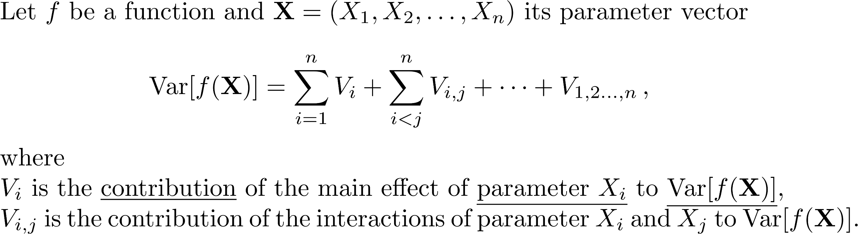
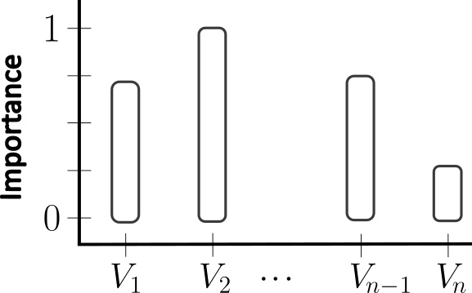
Sobol’ Method
First order
Sobol’ indices
Global methods consider the sensitivity of the output over an entire range of parameters
We need ranges
We need data!
Notes:
Sobol’ method is global sensitivity analysis method. It works for almost any function under some light restrictions, by decomposing the variance of the formula into summands which are the V_i s we can see here.
Those V_i s, are called Sobol’s indices and describe the contribution of the main of effect of each parameter to the overall variance of the formula.
There’s more to this story, such as how this decomposition is produced, what exactly are those contributions, but all we have to know for now is that the Sobol’ indices give as a way of quantifying how the output of mathematical function or model depends on one of its parameters.
The indices that we will talk about today take values between 0 and 1. The larger the value, the more important the parameter. Conversely, the smaller the value, the less important the parameter.
Global methods consider the sensitivity of the output over an entire range of parameters. So, to utilize this method we need suitable ranges for our biometric parameters, which means that we need data!

Slide 13
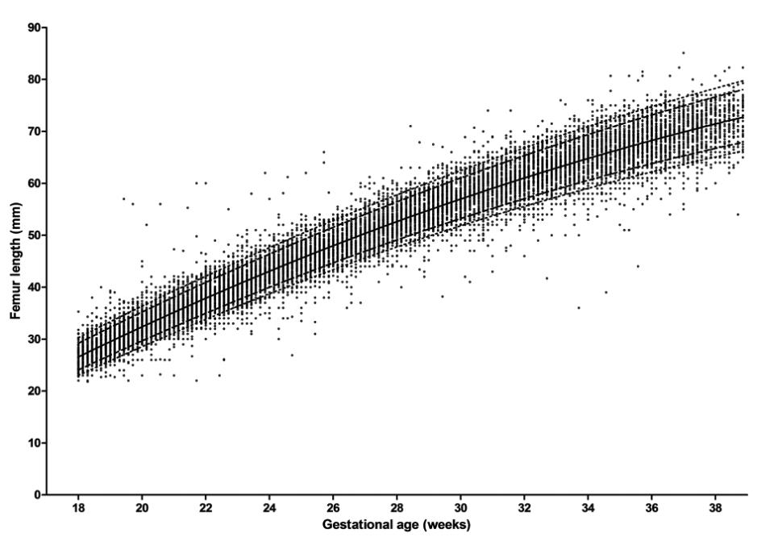
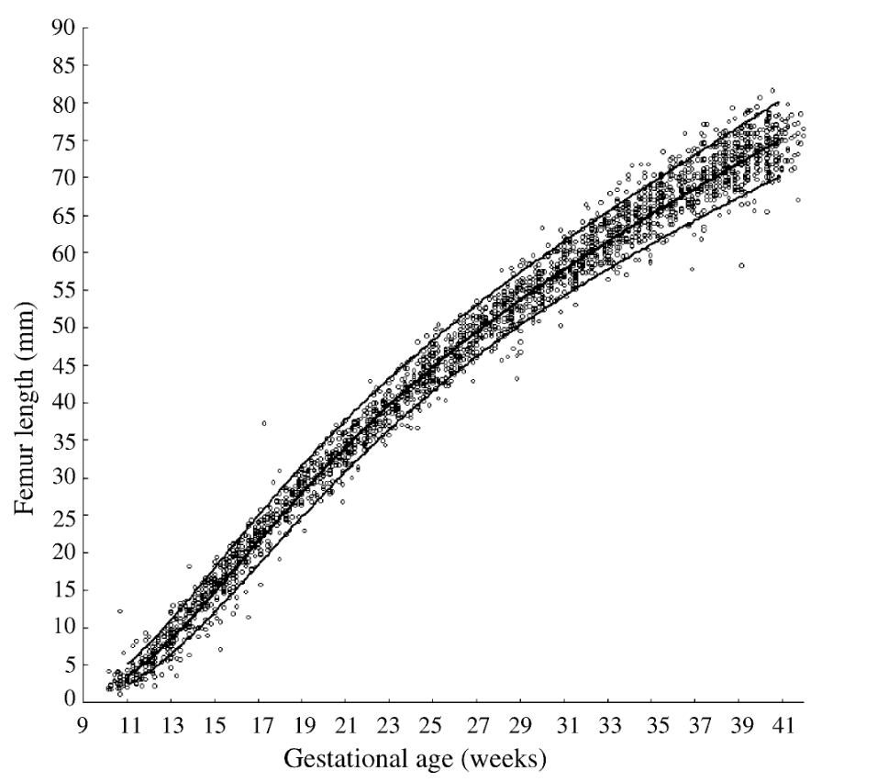
Data
A3
Growth Charts
Araujo Júnior, et al. (2014)
Johnsen, et al. (2004)
90th percentile
10th percentile
26 datasets from published studies spanning diverse populations and gestational ages were analysed, incorporating measurements of BPD, AC, HC and FL
Notes:
These two figures are called growth charts. They contain data monitoring how the FL of multiple fetuses changes throughout gestation. Both figures contain curves which signify the 90th percentile and the 10th percentile of each dataset across the whole gestation. We consider those percentiles to be the range of FL. We chose the ranges for the rest of the parameters similarly.
The two figures are taken from two different sources, however, these two sources are not the only ones we utilized...
Comment about the parameters being also week dependent

Slide 14
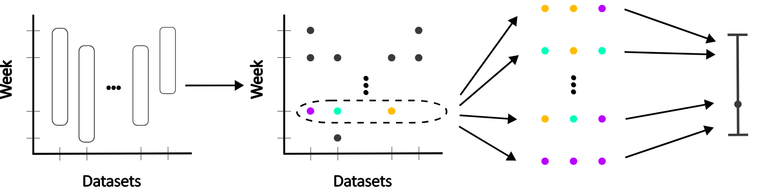
Framework
A4
Estimate median
and 95% CI
of the bootstrap distribution
of the mean Sobol’ index
for the specified week
Collect datasets
for the four biometric parameters
throughout the gestation
Compute Sobol’ indices
for a specific formula
for all available weeks
in each dataset
Resample all indices
computed for a single week
and calculate their mean
Notes:
So, time for our complete framework.
The first step involves collecting … just like we saw on the previous slide
The second step involves computing … . We can see that we can’t compute the Sobol’ index for all gestation weeks across every dataset because as we can see here the time span of the datasets varies.
The third step involves resampling … So basically, bootstrapping the computed Sobol’ indices
The final step involves estimating … with this being our final estimate of the Sobol’ indices.
The two last steps are then performed for every single gestation week. Then we begin the procedure again from step 2 until we’re done with all of our formulas.

Slide 15
B
Results
Notes:
Time to move on to the second part – the comparison framework!

Slide 16

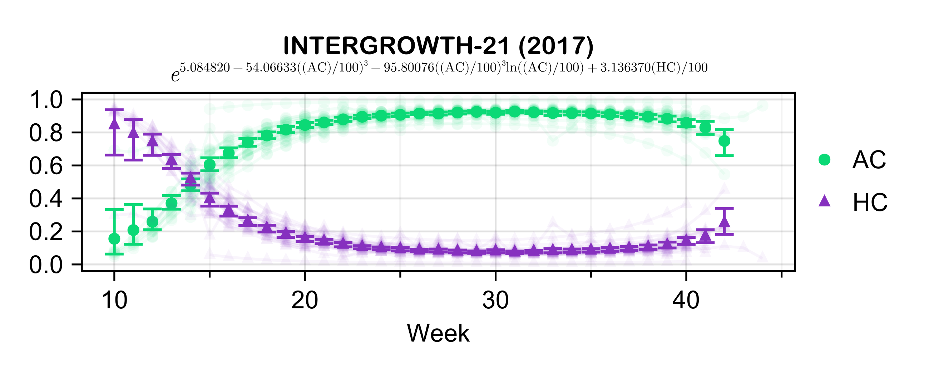
Findings
B1
95% CI
Sobol’ indices
for each dataset
Median of
the bootstrap distribution of the means
of Sobol’ indices
Notes:
Let’s take some time with the first figure so we can properly understand it.
In the x-axis we see the gestational age, meaning how far along the pregnancy is. In y-axis we have the magnitude of the sobol’ indices.
The index of the biometric parameters are coded with different colors and markers. For example, AC is coded with green and circles and HC is coded and purple and triangles.
The markers inside the figure represent the … which is ultimately our estimate for the Sobol’ indices
The range bars represent a 95% CI.
Finally, those semi-transparent curves we spot on the back are the Sobol’ indices for each dataset, essentially the samples used for the bootstrapping.
So, with that out of the way, we can see that the INTERGROWTH-21 formula exhibits a cross over effect in parameter importance. AC starts with being insignificant early on and proceeds to being the dominant parameters later on during pregnancy. The opposite happens for HC.

Slide 17
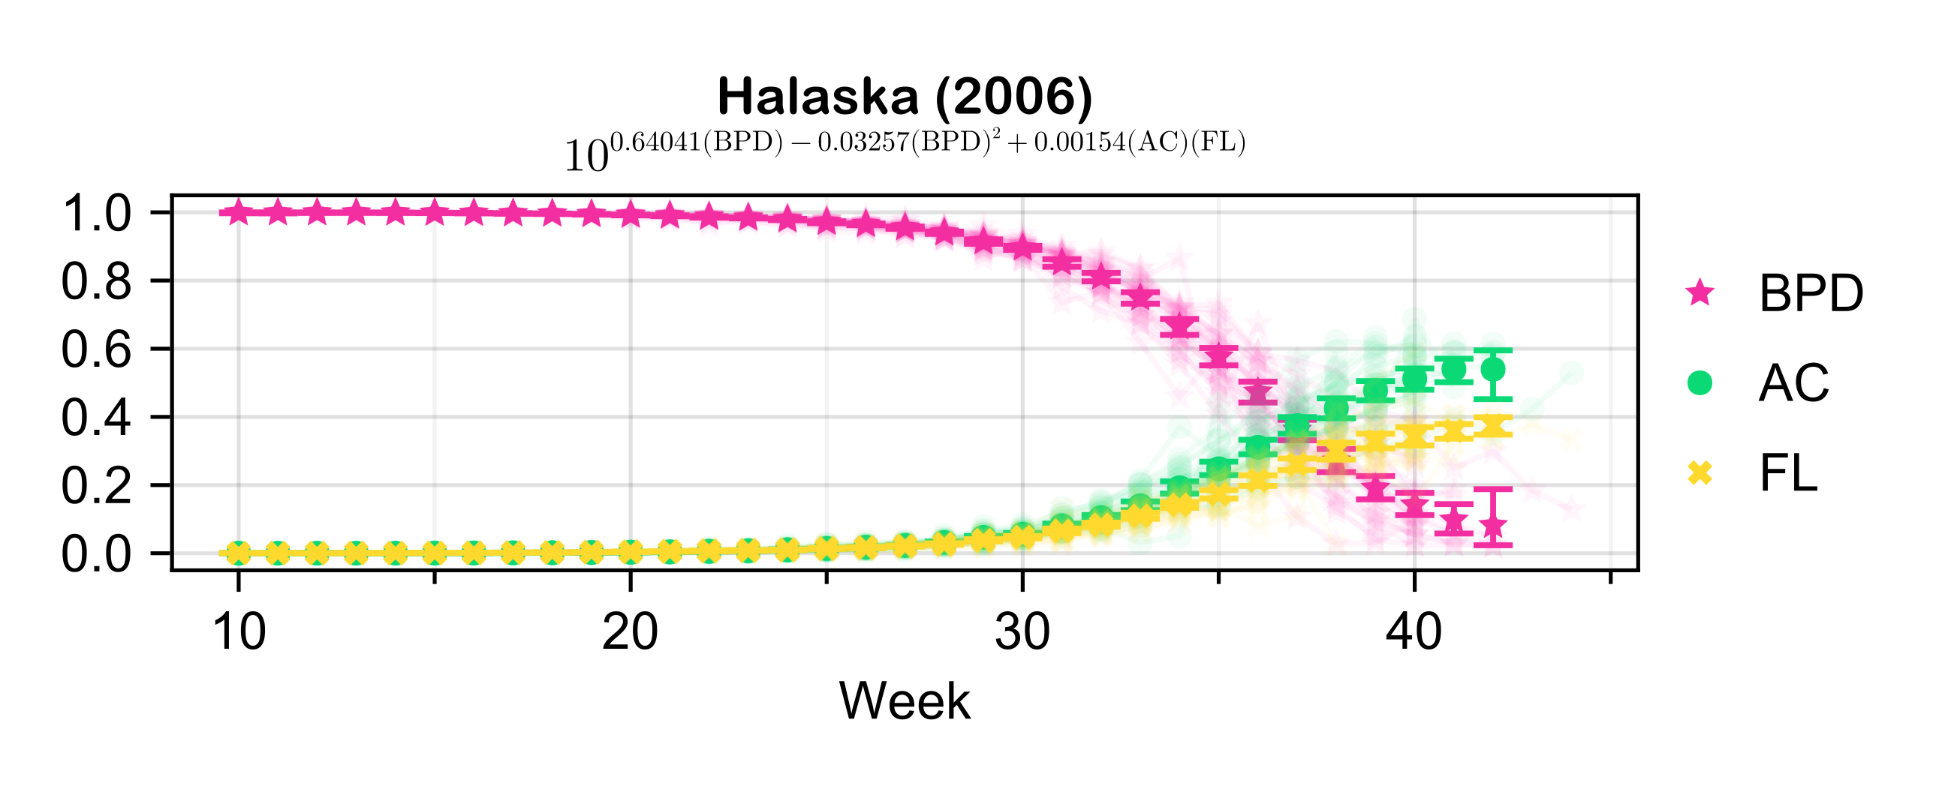
Due date
Notes:
This cross over effect doesn’t only happen at the beginning of the pregnancy, but can also happen later on. Even close to the due date, which is around 37 to 42 weeks of gestation, a time when estimating the fetal weight is far more important.
Hence, clinicians using the Halaska formula should be aware of this effect and adapt accordingly.

Slide 18
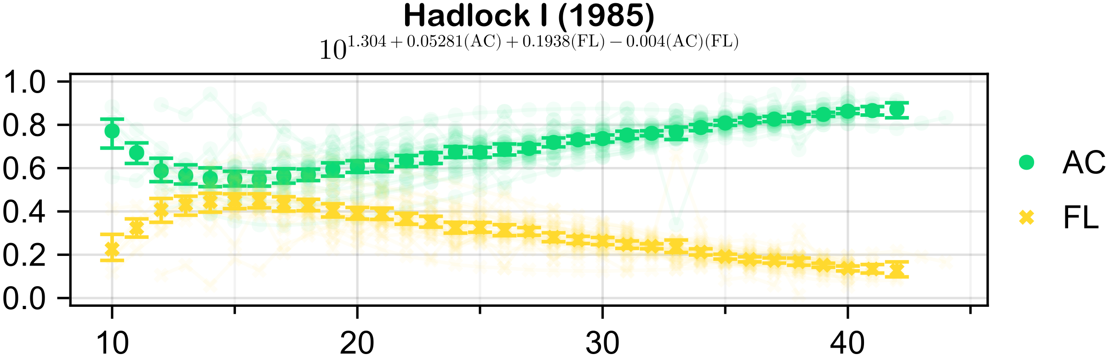
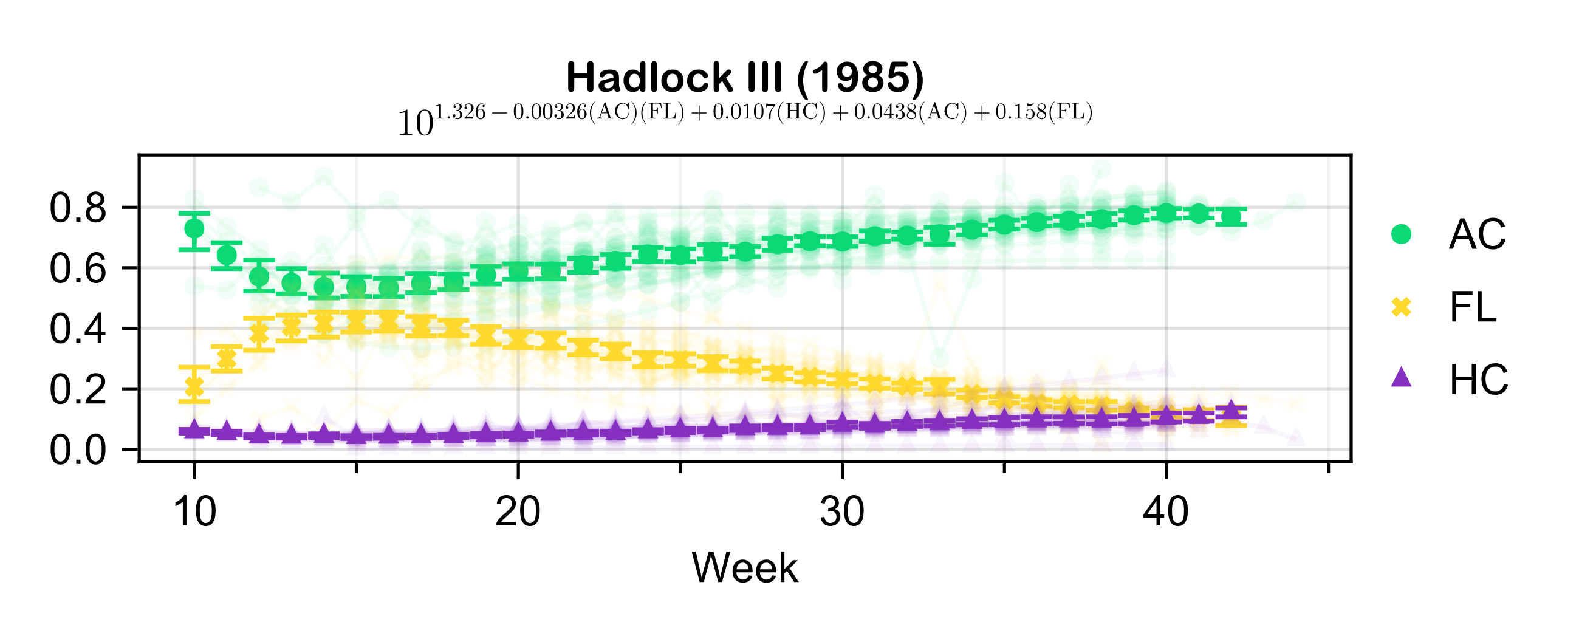
Parsimony
AC and FL
are almost identical
throughout the gestation
HC is insignificant
throughout the whole gestation
Notes:
Another interesting result regards the parsimony of the models. These two formulas are some of THE most used formulas in the clinical setting. In the second formula, we notice that BPD and HC are almost completely insignificant throughout the whole gestation. At the same time the importance of AC and FL are similar for both formulas.
Remember, our results say nothing about the accuracy of the formulas, yet right now we are faced with two similar formulas, with one of them just having redundant parameters. Hence, we can say that formulas like Hadlock’s IV are not parsimonious.

Slide 19



Summary of key findings
B2
Half of the formulas include at least one parameter with minimal contribution
AC is insignificant in 4%
of the formulas that it appears in
(HC: 20%, BPD: 33%, and FL: 37%)
Only two of the formulas
have a dominant parameter
throughout the gestation

Slide 20


AC is considered a crucial parameter
in fetal weight estimation
however, its contribution depends on
both the choice of the formula and the gestation age
66% of the formulas exhibit a crossover in parameter importance
over the course of gestation
i.e., some transition from low‑to‑high significance,
while others decline from high to low

Slide 21



Implications
B3
Clinicians should select formulas based on gestational age, measurement reliability
and fetal characteristics
Estimates made with fewer than the intended parameters can be viable in emergencies
The refinement of existing formulas
and the development of improved
fetal weight estimation models
can be achieved through the proposed methodology

Slide 22

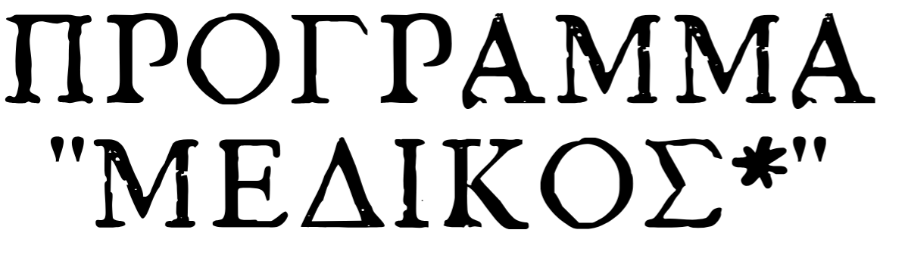

Thank You!
V. Bitsouni, N. Gialelis, and V. Tsilidis,
Partial dependence of ultrasonically estimated
fetal weight on biometric parameters,
Royal Society Open Science (2025)

